Slide 1
Home Loans Data Science Project

Slide 2
Agenda
Data Science Lifecycle
Project Overview
Process Overview
Data
Analysis
Modeling
Model Evaluation
Recommendations

Slide 3
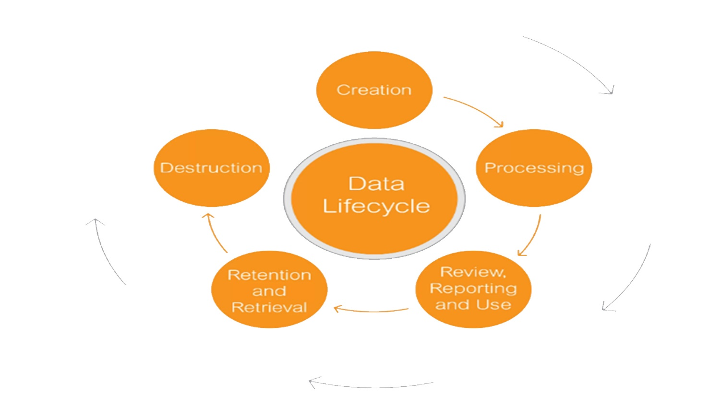
Data Science Lifecycle

Slide 4
Project Overview
Business Problem: Currently the home loan application process is a manual one. It which takes 2-3 days, which mean that the applicant will only be notified after 2-3 days of the application outcome.
Business Objective: Reduce the amount of time it takes for applicants to be notified about their loan statuses (to a matter of seconds).
Hypothesis: Based on historical data we can use machine learning to predict the loan status of a potential borrower such that the time taken for them to receive their respective statuses is reduced significantly.

Slide 5
Process Overview / Solution
Applicants fill out their information on any device (Gender, Marital Status, Income, etc.). The machine learning model will then make a prediction based on historical data. The prediction will appear on the device as Accept or Decline on the same device in a matter of seconds

Slide 6
Data
The number of records – 614
The number of columns – 13
The number of numerical columns – 5
The number of categorical columns – 8
Target/Loan Status – Y (422) vs N (192)

Slide 7
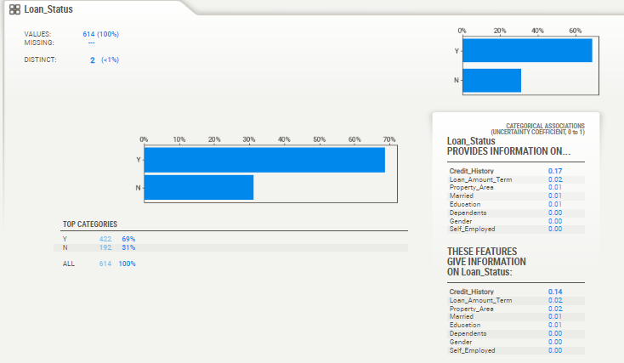
Analysis

Slide 8
Modeling
A device getting to know version changed into skilled and AutoML was used as nicely. - Bespoke models require preprocessing - AutoML did now not - outcomes are pretty similar

Slide 9
Model Evaluation
AutoML
Bespoke ML
Accuracy
79%
77%
- where accuracy is the total of all the right predictions produced by the model over all forecasts.

Slide 10
Recommendations
Bespoke ML trumps AutoML We are fully aware of what was used, how it was used, and what algorithm was employed to accomplish the goal.
Less training time (works in our favour if we train and predict in real time – maybe not applicable in this use case)It is advisable to utilise AutoML as a foundational model.

